Slide 1

DROWSINESS DETECTION SYSTEM
Project Presentation
Winter Semester 2023-24
Project Guide :
Dr Zafar Alam
Assistant Professor
Department of Mechanical Engineering
Presented by
Abishekh Kumar 19JE0048

Slide 2
Introduction
The attention position of driver degrades because of lower sleep, long nonstop driving or any other medical condition like brain diseases etc. Several checks on road accidents says that around 30 percent of accidents are caused by fatigue of the motorist. When driver drives for further than normal period for mortal also inordinate fatigue is caused and also results in frazzle which drives the motorist to sleepy condition or loss of knowledge. Drowsiness is a complex miracle which states that there's a drop in cautions and conscious situations of the driver. Though there's no direct measure to descry the drowsiness but several other indirect approaches can be used for this purpose.

Slide 3
Objective
The design aims to achieve the following
The purpose of this study was to look at the physical goods of prostration and doziness.
To produce a system that detects prostration and doziness by closing eyes and yawning.
Early Detection of Drowsiness
Real-time Monitoring
Alert Generation
Intervention Mechanisms
Data Collection

Slide 4
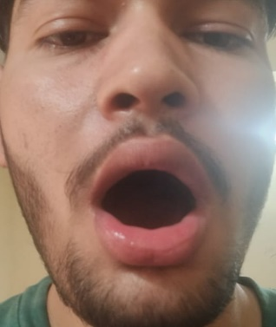
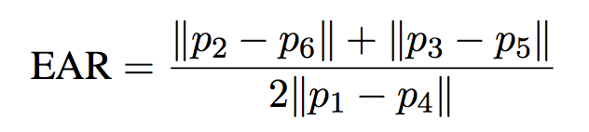
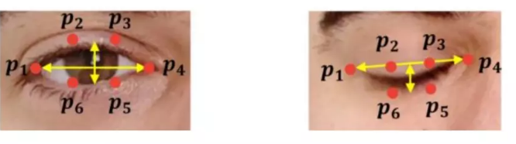

Technology used
OpenCV
Dlib library
Android studio
Python
Equations involved
MAR =

Slide 5
Open Mouth Detection: Yawning is characterized by wide opening of mouth. Facial landmarks can be used to detect an open. mouth. Mouth is characterized with the help of 20 coordinates. Using these coordinates, the distance between lip is calculated which is the difference between top lip and bottom lip and this lip distance is used to determine whether the driver's mouth is open. If the lip distance is greater than a threshold amount the subject is determined to be yawning and an alert is given accordingly.
The proposed method was initially implemented using a laptop with attached webcam of 15 frames per second. The system was tested. Figure shows the output when the subject is yawning. The visual output contains eye and mouth aspect ratio and the audio output is an alert message which include the signal Sleepy. Facial landmarks are detected and displayed. Corresponding EAR value, MAR value and status is displayed in turn an alert alarm was also generated as audio output

Slide 6
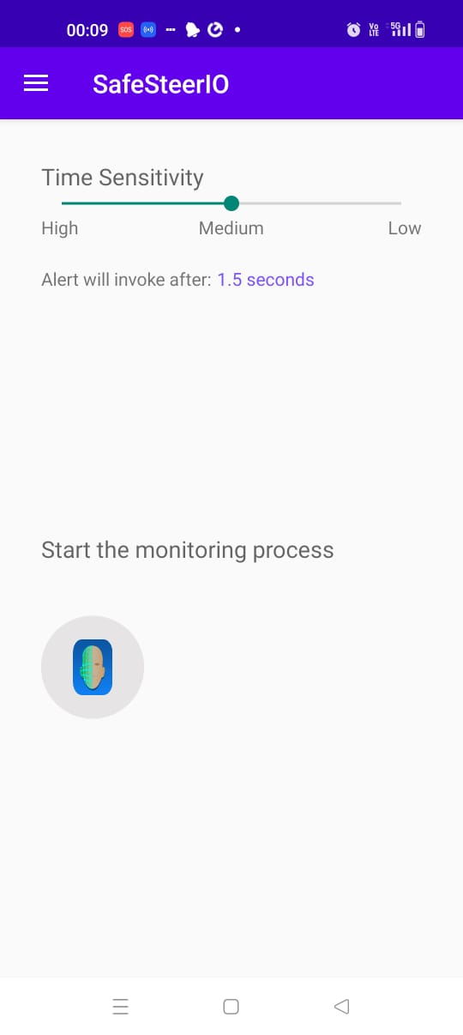
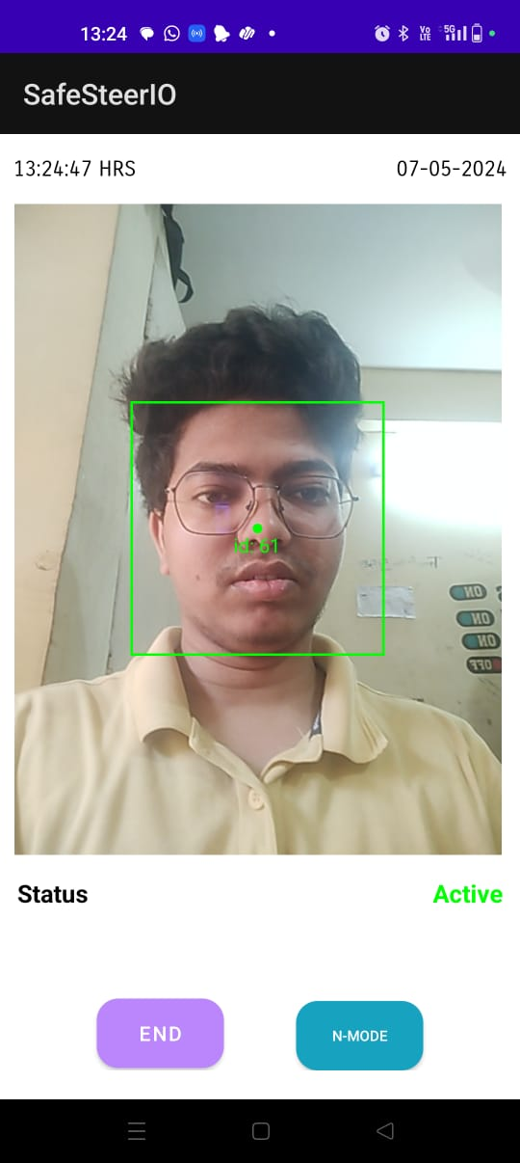
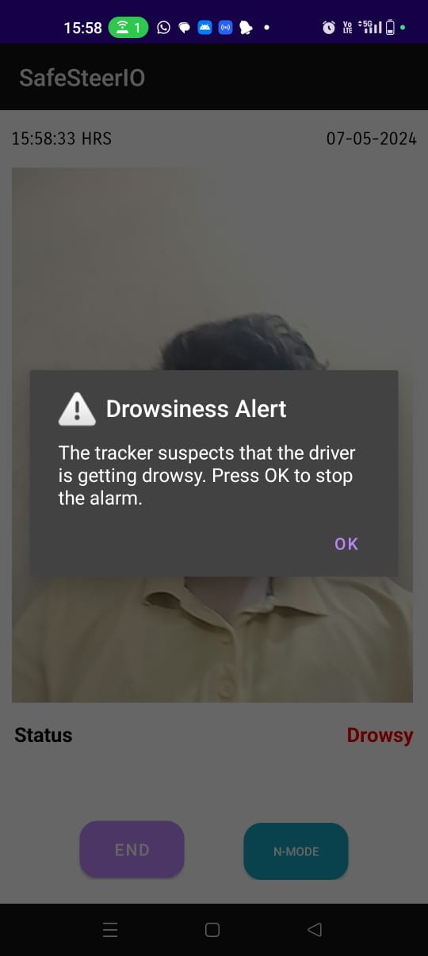
Android App interface
If count is less than 5, it sets the text to "Active" with green color.
If count is between 5 and 8, it sets the text to "Sleepy" with yellow color.
If count is greater than 8, it sets the text to "Drowsy" with red color.

Slide 7
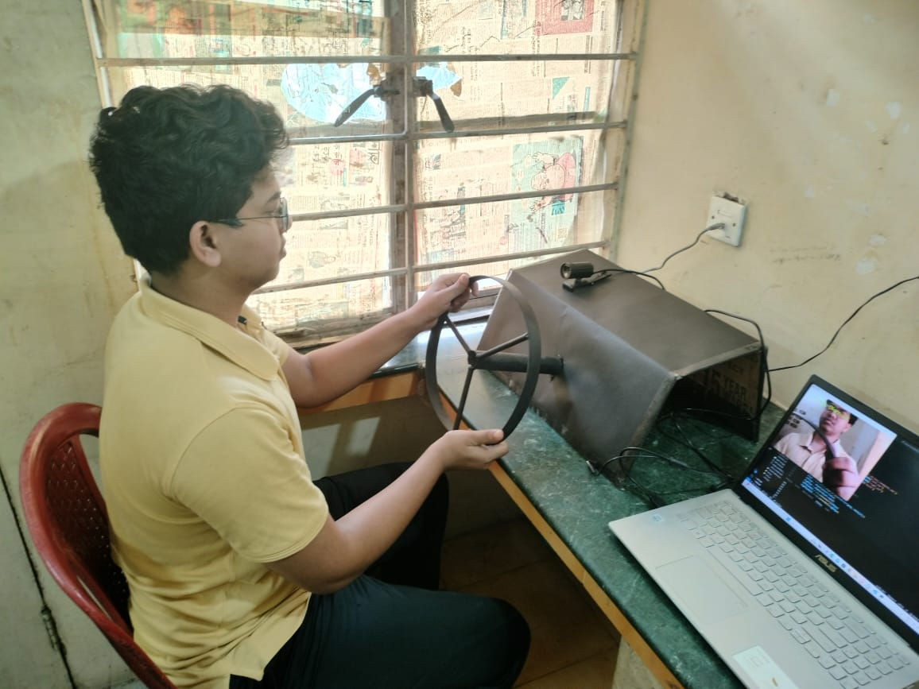

Slide 8
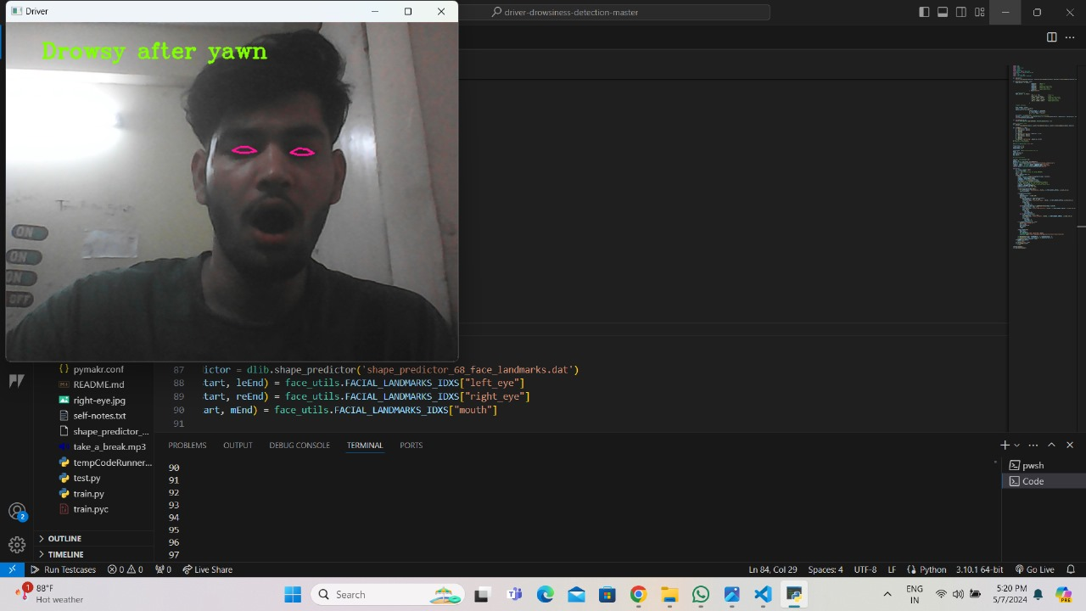
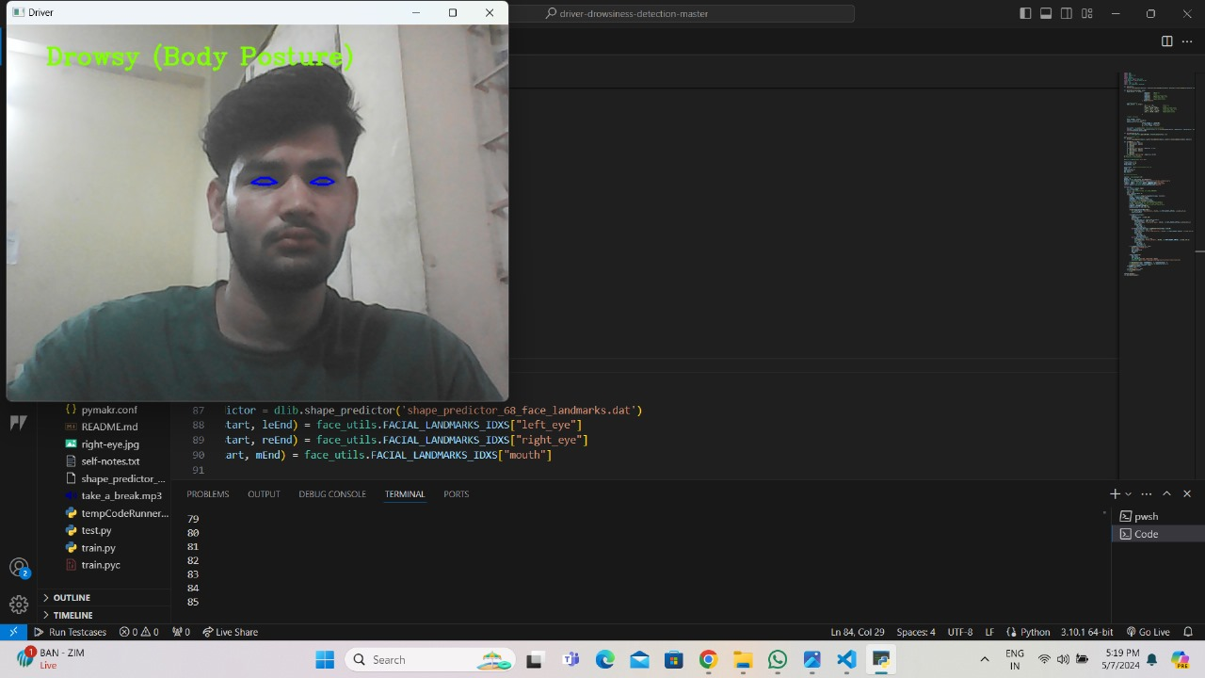
Results
Upon detection, the system triggers alerts, utilizing both audio alarms and visual cues, to promptly notify the driver. The effectiveness of the system is reflected in the dynamic adjustment of the alertness level displayed on the user interface, providing immediate feedback on the driver's state.

Slide 9
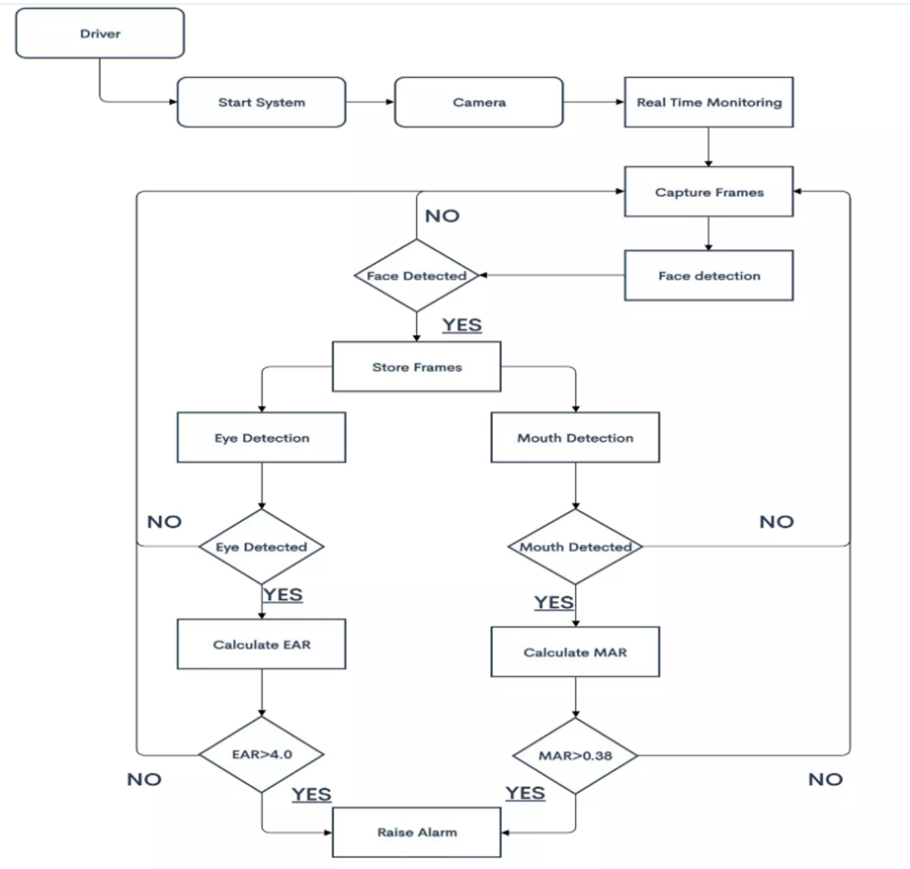

Slide 10
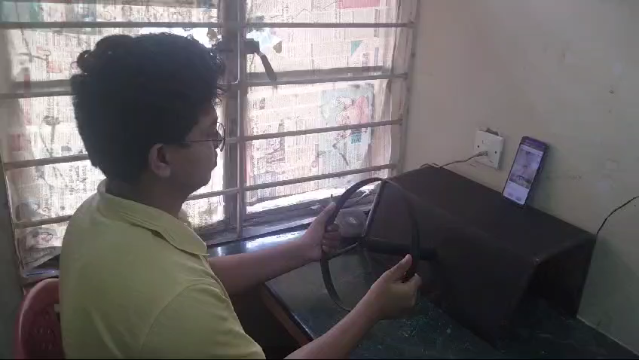
Alerts and Notifications: The app may provide timely alerts and notifications to the driver when it detects signs of drowsiness, such as slow reaction times or erratic driving behavior.
Improved Driver Awareness: Drivers may become more aware of their drowsiness patterns and the importance of taking breaks during long drives, leading to safer driving habits.
Reduced Accidents: By alerting drivers to their drowsy state, the app may help reduce the number of accidents caused by fatigue or falling asleep at the wheel.
Increased Safety: If the app effectively detects signs of drowsiness while driving, it can help prevent accidents by alerting the driver to take breaks or rest.
Battery Drain: Continuous use of the app while driving may drain the smartphone's battery faster, especially if it requires constant monitoring or utilizes sensors extensively.

Slide 11
Conclusion
Android-based drowsiness detection system represents a significant stride towards enhancing road safety through innovative technological solutions. By harnessing the power of facial tracking algorithms, our application accurately detects instances of driver drowsiness and sleepiness in real-time, offering a proactive approach to mitigate potential risks of accidents due to driver fatigue. Furthermore, our integration with Arduino hardware, coupled with laptop-based monitoring, extends the applicability of our system beyond the mobile platform, providing a versatile solution that can be seamlessly incorporated into various vehicle setups.
Future work
Standalone Product:
As a standalone product, drowsiness detection alerting devices can be further refined and commercialized for widespread adoption in vehicles of all types, including cars, trucks, buses, and even airplanes.
These devices could be manufactured in compact and sleek designs, easily mountable on the dashboard or integrated into existing vehicle systems.
In the context of co-pilot systems, drowsiness detection alerting devices could serve as an integral component of advanced driver assistance systems (ADAS).

Slide 12
References
[1] Jay D. Fuletra and Dulari Bosamiya, "A Survey on Driver's Drowsiness Detection Techniques", International Journal on Recent and Innovation Trends in Computing and Computation, Volume: 1, Issue: 1
[2]M. Ramzan, H. U. Khan, S. M. Awan, A. Ismail, M. Ilyas and A. Mahmood, "A Survey on State-of-the-Art Drowsiness Detection Techniques," in IEEE Access, vol. 7, pp. 61904-61919, 2019.
[3] Mohamad-Hoseyn Sigari, Muhammad-Reza Pourshahabi, Mohnsen Soryani and Mahmood Fathy, "A Review on Driver Face Monitoring Systems for Fatigue and Distraction Detection", International Journal of Advanced Science and Technology Vol.64.pp 73-100
[4] Bappaditya Mandal, Liyuan Li, Gang Sam Wang and Jle Lin, "Towards Detection of Bus Driver Fatigue Base on Robust Visual Analysis of Eye State", IEEE Transactions on Intelligent Transportation Systems, vol 18, No. 3. March 2017
[5]Vahid Kazemi and Sullivan Josephine, "One Millisecond Face Alignment with an Ensemble of Regression Trees", 27th IEEE Conference on Computer Vision and Pattern Recognition, CVPR 2014, Columbus, United States, 23 June 2014 through 28 June 2014
[6] Christos Sagonas, Georgios Tzimiropoulos, Stefanos Zafeiriou and Maja Pantic, "300 Faces in-the-Wild Challenge: The First Facial Landmark Localization Challenge, IEEE International Conference on Computer Vision Workshop, 2013
[7] Tereza Soukupova and Jan Cech "Real-Time Eye Blink Detection using Facial Landmarks", 21st Computer Vision Winter Workshop, Luke Cehovin, Rok Mandeljic, Vitomir Struc (eds.) Rimskke Toplice, Slovenia, February 3-5 2016.

